Slide 1
WELCOME

Slide 2
BUS RESERVATION SYSTEM PROGRAM IN C++
GANPAT UNIVERSITY
CSE BDA
PPT BY KRISHNA MANIAR
21162121011
ESSENTIAL OF SOFTWARE FOUNDATION & PROGRAMMING-II

Slide 3
HEADER FILES
iostream: iostream stands for standard input-output stream. This header file contains definitions of objects like cin, cout ,etc.
string.h : This header file contains macro definitions, constants and declarations of functions and types used not only for string handling but also various memory handling function
cstring : The cstring header file contains definitions for C++ for manipulating several kinds of strings . cstring tracks the length of character data so that it can more securely watch the data and the space it requires .

Slide 4
CONCEPTS USED IN PROGRAM
Class & Object : A class is defined in C++ using keyword class followed by the name of class. The body of class is defined inside the curly brackets and terminated by a semicolon at the end. Declaring Objects: When a class is defined, only the specification for the object is defined; no memory or storage is allocated.
Loops :
if ➔if statement is the most simple decision-making statement. It is used to decide whether a certain statement or block of statements will be executed or not
else ➔We can use the else statement with if statement to execute a block of code when the condition is false.
while ➔ A while loop evaluates the condition. If the condition evaluates to true , the code inside the while loop is executed. The condition is evaluated again. This process continues until the condition is false .

Slide 5
BUILT-IN FUNCTIONS
int main() : 'int main' means that our function needs to return some integer at the end of the execution and we do so by returning 0 at the end of the program. 0 is the standard for the “successful execution of the program” .
getline () : ‘getline’ is an in-built function defined in the <string. h> header file that allows accepting and reading single and multiple line strings from the input stream.
getchar() : ’ getchar’ function is equivalent to a call to getc(stdin). It reads the next character from stdin which is usually the keyboard .

Slide 6
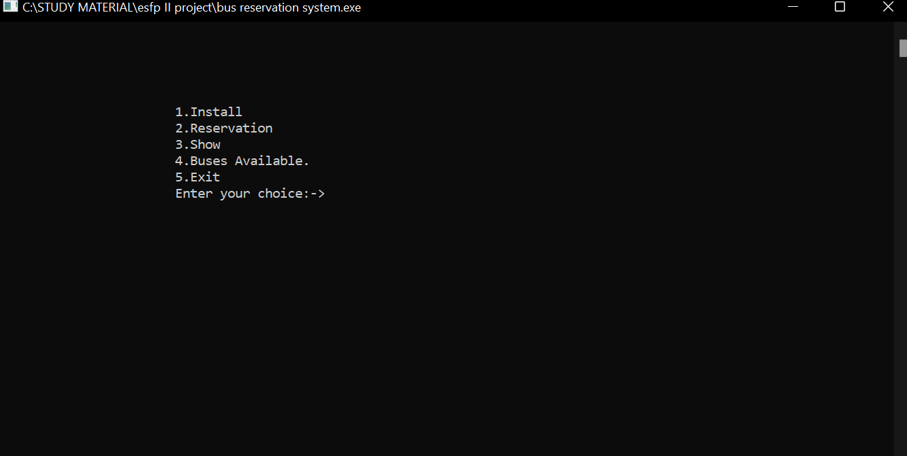
This shows the output for booking a reservation seat

Slide 7
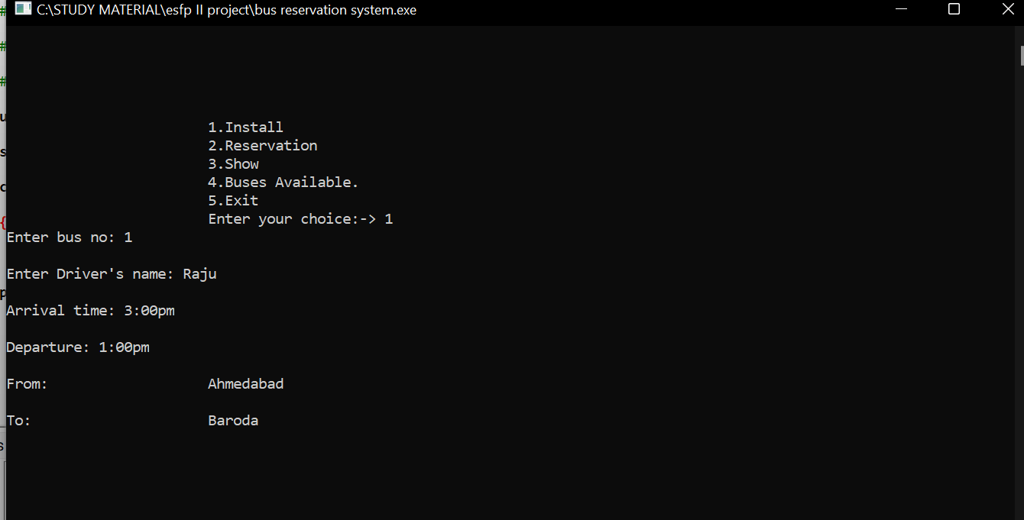
Inserting the data of bus information

Slide 8
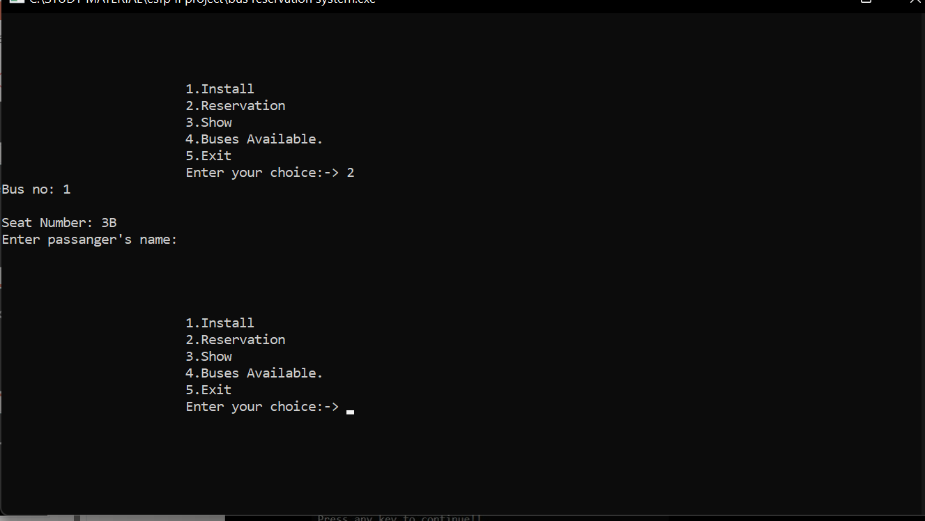
To reserve the bus seat

Slide 9
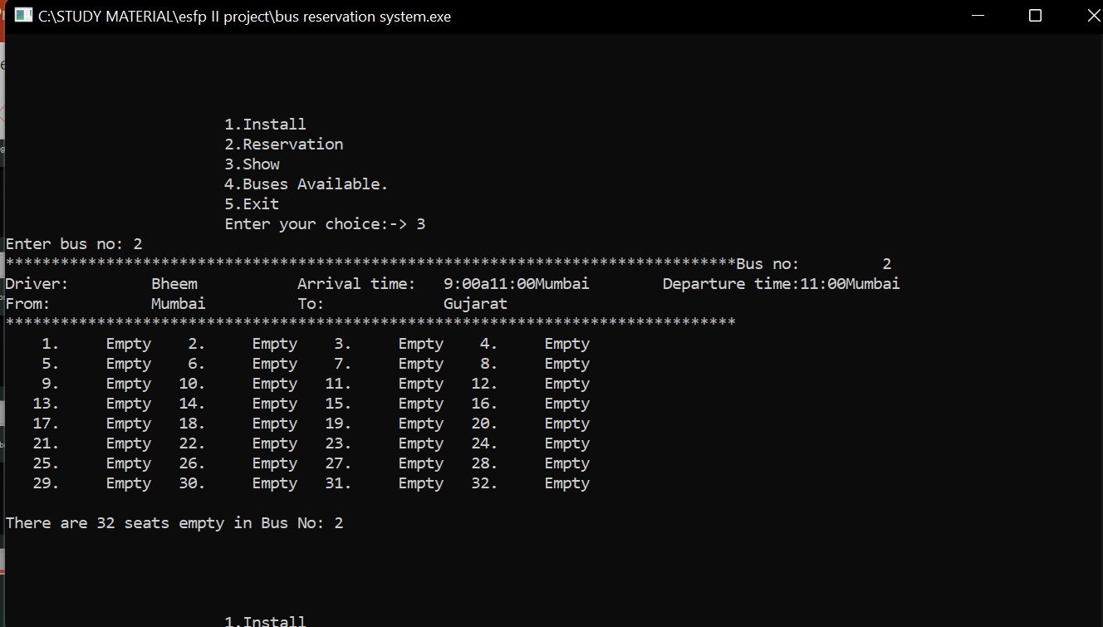
Show the data of bus

Slide 10
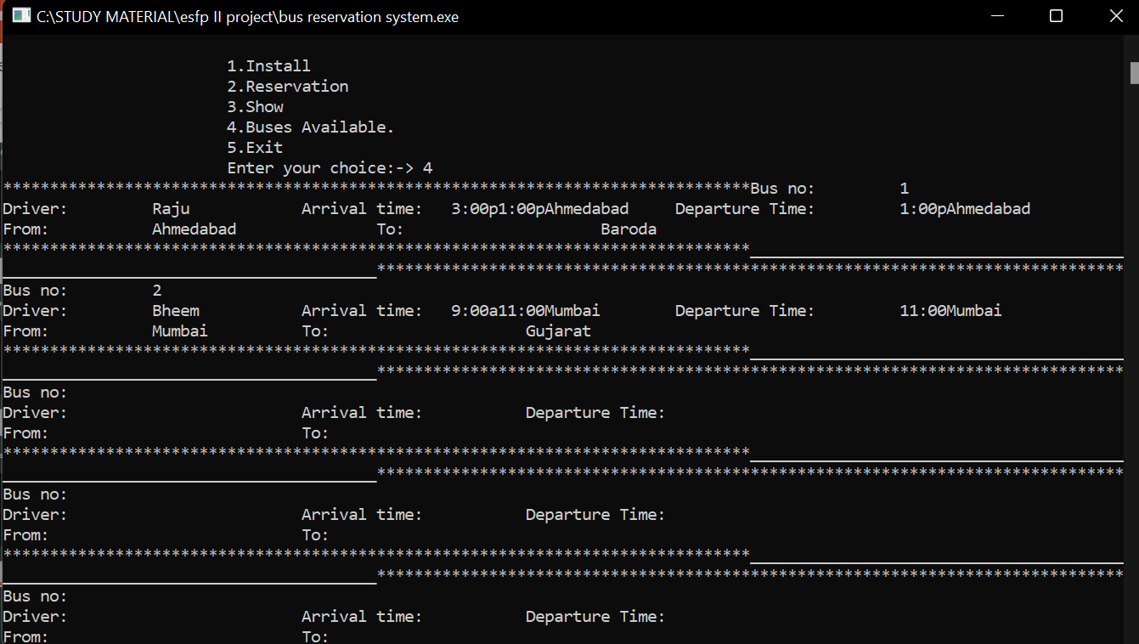
Buses Available for booking a reservation

Slide 11
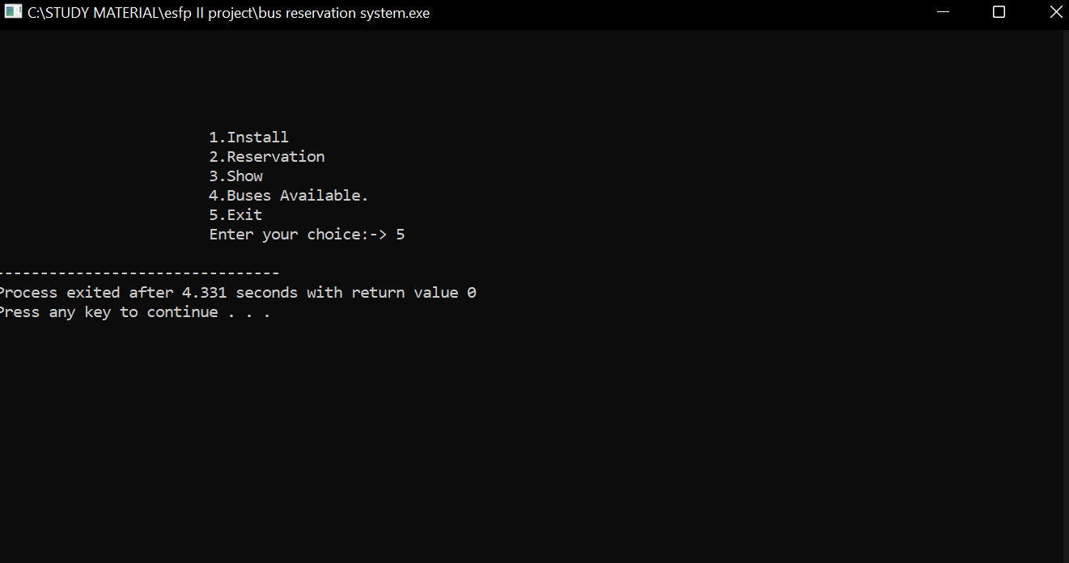
After Reserving the bus seat you can exit

Slide 12
THANK YOU !

